Slide 1


DATA ACES INTERNSHIP 3 WEEK REPORT
R Advaith

Slide 2
Roadmap of 3 Weeks:
edX Courses
Embeddings with OpenAI API
Summarisation, Classification
Sentiment Analysis

Slide 3

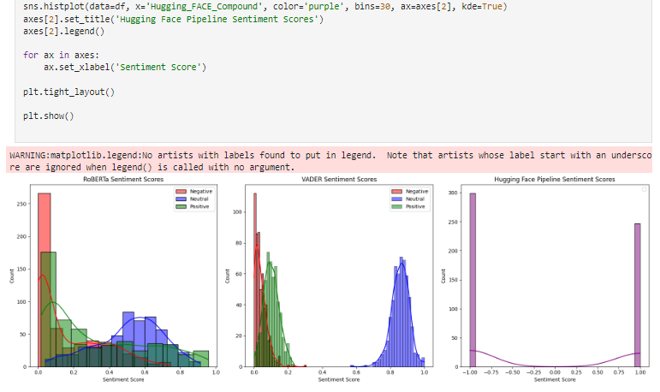


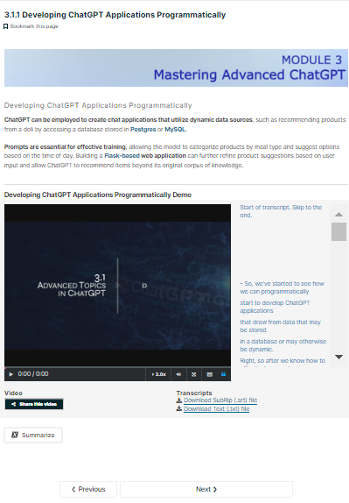
edX Courses:
Introduction to ChatGPT.
Prompt Engineering and Advanced ChatGPT.
How to Use ChatGPT in Business.
Embeddings OpenAI API:
Integration of LLMS:
Used OpenAI API to convert Text To Embeddings.
Response Bot using Da-Vinci Turbo 3.5 model reading PDF.
Answers based on keyword from the PDF.
Integrated open source LLMS for NLP tasks Summarisation, Category Mapping (SpaCy, BERT, BART, RoBERTa, NLTK).
Performed category mapping and compared similarity percentage for over 600+ data points (Fuzzywuzzy, MiniLM-L6-v2, SpaCy, NLTK).
Compared the efficiency of Vader, RoBERTa and Huggingface pipeline in sentiment analysis.

